Slide 1
CONTENTS
Abstract
Introduction
Existing system
Limitations
Proposed system
Thesis statement
Modules
System Requirement Specifications
Design
Screen shots
Conclusion

Slide 2
Abstract
Location based spatial query processing is one of the most common and popular approaches for retrieving Location of the user
We show that LBSQ s has certain unique characteristics that the traditional spatial query processing in centralized databases does not address.
The advantage of this method is to decrease the Latency by
Using caching techniques

Slide 3
Introduction
Location based spatial query’s refers to “A set of spatial queries the retrieve information based on the mobile users current location”
Efficient processing of LBSQ s is of critical importance with the ever-increasing deployment and use of mobile technologies

Slide 4
Existing System
  Existing techniques cannot be used effectively in a wireless broadcast environment, where only sequential data access is supported.
  It may not scale to very large user populations.
  an existing system to communicate with the server, a client must most likely use a fee-based cellular-type network to achieve a reasonable operating range.
  Third, users must reveal their current location and send it to the server, which may be undesirable for privacy reasons.

Slide 5
Limitations
    Mobile Query Semantics
    High Workload
    Query Promptness
    Accuracy

Slide 6
Proposed System
This System is a novel approach for reducing the spatial query access latency by leveraging results from nearby peers in wireless broadcast environments.
Our scheme allows a mobile client to locally verify whether candidate objects received from peers are indeed part of its own spatial query result set.
The method exhibits great scalability: the higher the mobile peer density, the more the queries answered by peers.
The query access latency can be decreased with the increase in clients.

Slide 7
THESIS STATEMENT
The main aim of this project is to Reduce the spatial Query access Latency in wireless broadcast environments by using the caching techniques.

Slide 8
SYSTEM REQUIREMENT SPECIFICATIONS
Hardware Requirements:
Processor : Intel Pentium 4
RAM : 1GB
Hard Disk : 80 GB
Software Requirements:
Operating System : Microsoft Windows XP Professional
Language : JDK 6.0

Slide 9
SYSTEM DESIGN

Slide 10
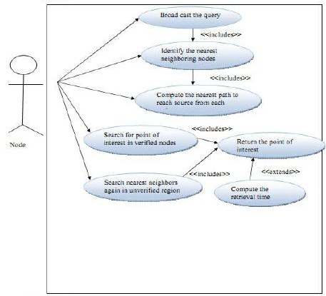
Use case diagaram:

Slide 11
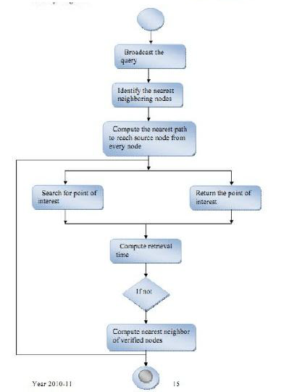
Activity diagram

Slide 12
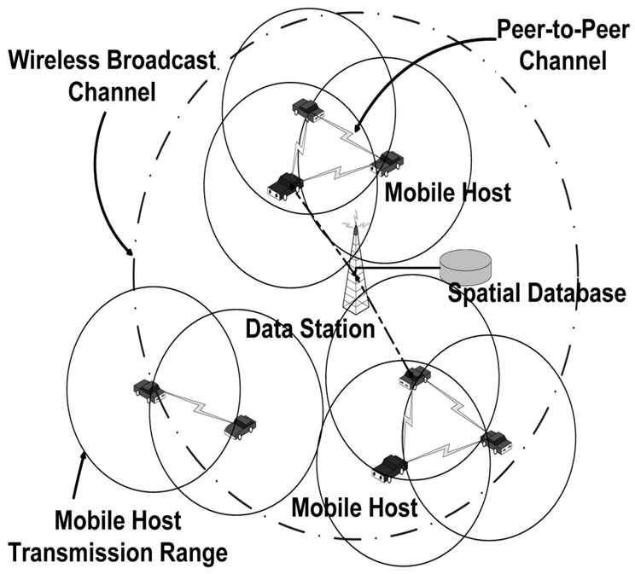
System Environment:

Slide 13
Module1
.
Mobile Host1
Centralized Server

Slide 14
Module2
Mobile Host2
Finding nearest Neighbor
Mobile Host 1

Slide 15

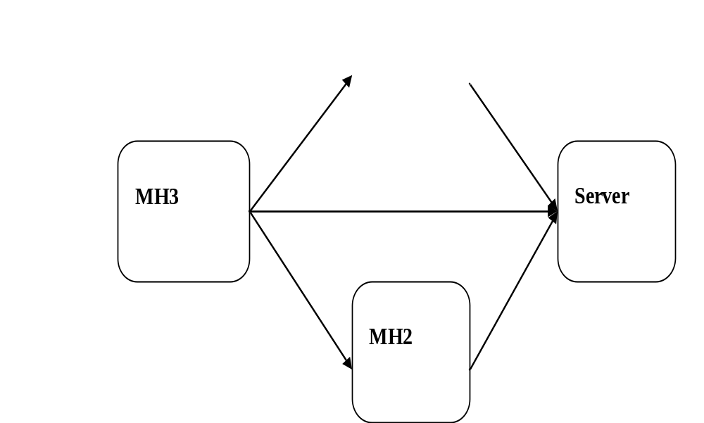
Module3

Slide 16
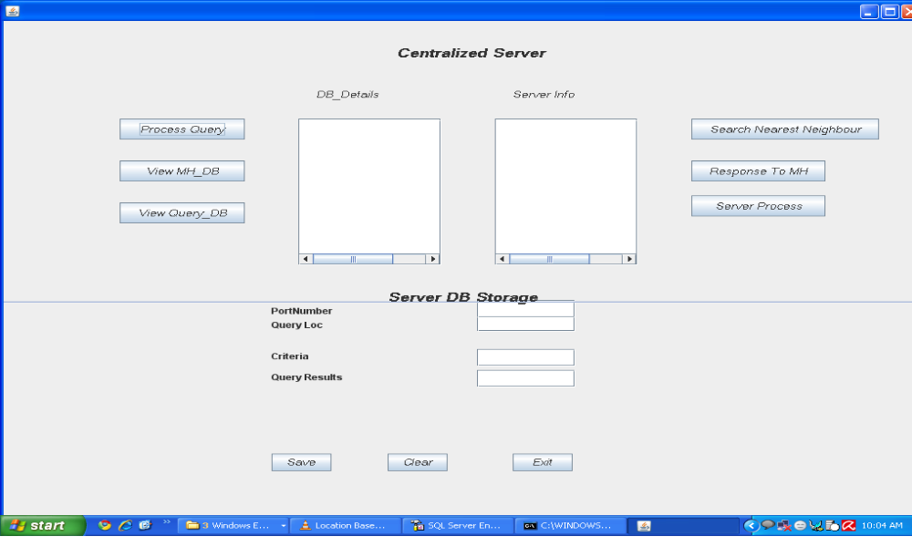
Centralized Server

Slide 17
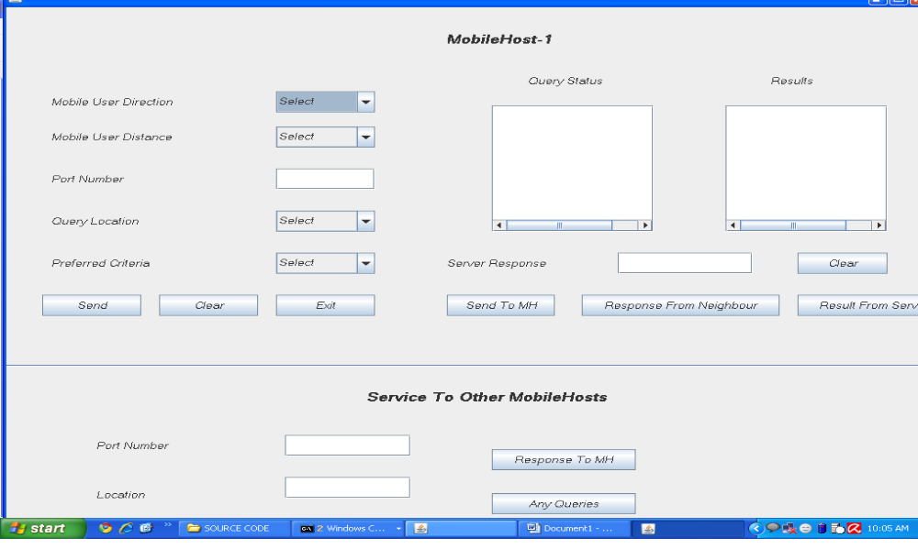
Mobile Host-1

Slide 18
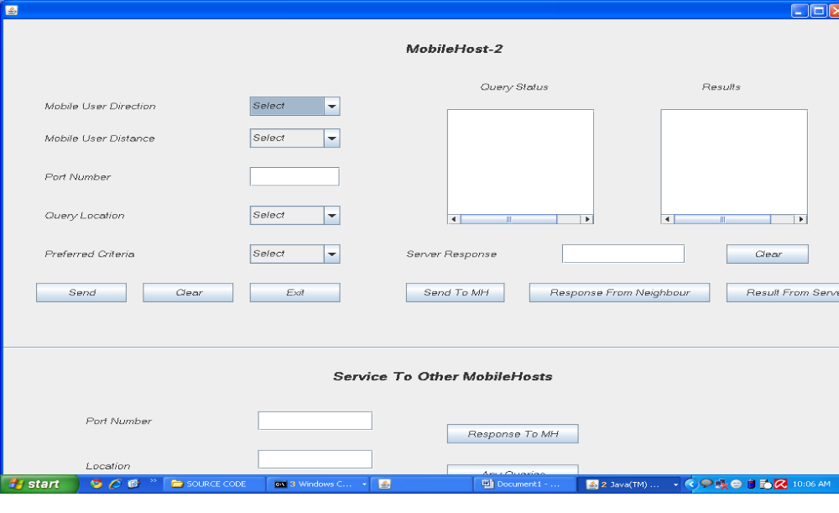
Mobile Host-2

Slide 19
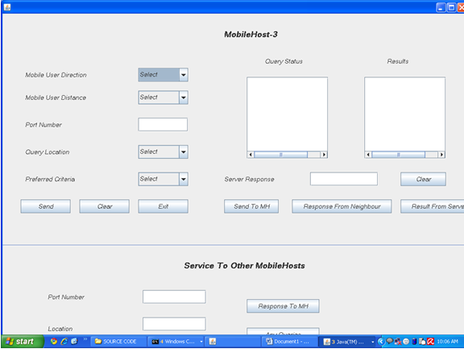
Mobile Host-3

Slide 20
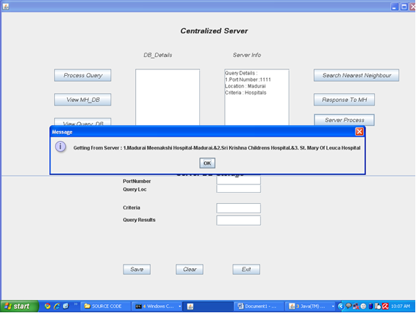
Centralized Server

Slide 21
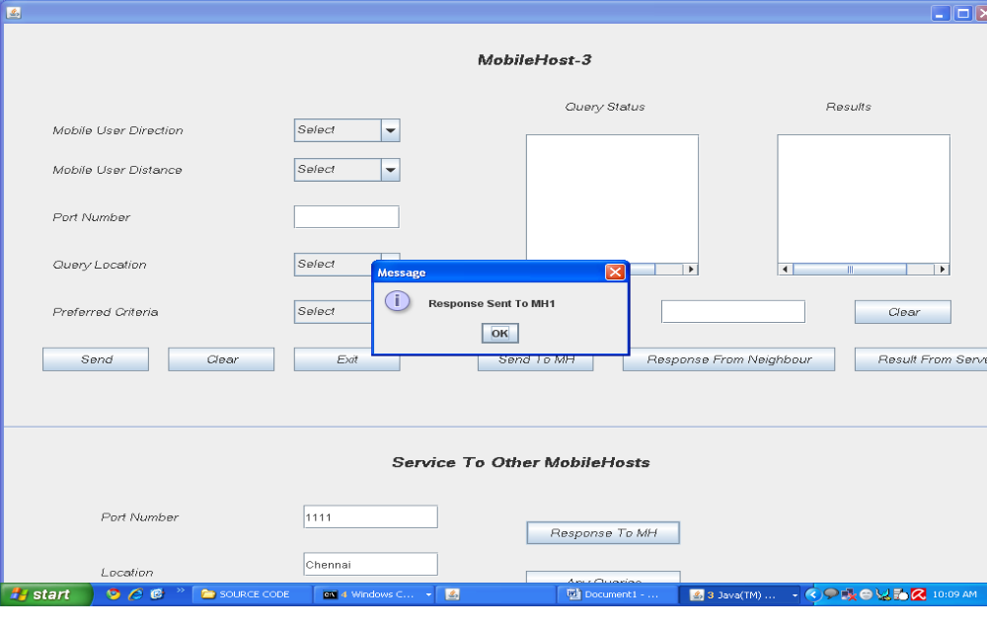
Mobile Host-3

Slide 22
Conclusion
Reduce the spatial query access latency in wireless broadcast environments.
our scheme allows a mobile client to verify whether candidate objects received from peers are indeed part of its own spatial query result set.
This is achieved with minimal caching at the peers.
By virtue of its P2P architecture, the method exhibits great scalability: the higher the mobile peer density, the more the queries answered by peers.
Therefore, the query access latency can be markedly decreased with the increase in clients.

Slide 23
?
?
?
?
?
Thank You
Queries?
?
?
?
?
?
?

Slide 24
Any Sugessions…..

